Slide 1
Programming for Business
Session 7–8 (LO3)
Dictionaries, Sets & Decision Structures
FAST–NUCES | Semester 2
Notes:
Today’s class is intentionally detailed. Students were confused previously, so we will use full company use cases, draw diagrams on the board, and clearly identify why one data structure is correct and others are wrong.

Slide 2
Learning Outcomes
After this class, students will be able to:
Clearly explain tuples, lists, sets, and dictionaries
Choose the correct data structure for a company scenario
Apply decision structures using if and if-else
Explain Boolean logic using real business rules

Slide 3
Difference?
Tuple vs List
Set vs List
Dictionary vs Set

Slide 4
Example 1: Invoice Record
Scenario: A company generates an invoice after a customer pays.
Data stored:
Invoice Number
Invoice Date
Total Amount
Why Tuple?
Invoice is a legal document
Data must not change after generation
Changing amount/date can cause fraud and audit issues
Explanation:
“Once an invoice is issued, it becomes official. We should not allow anyone to change its values, so we use a tuple.”

Slide 5
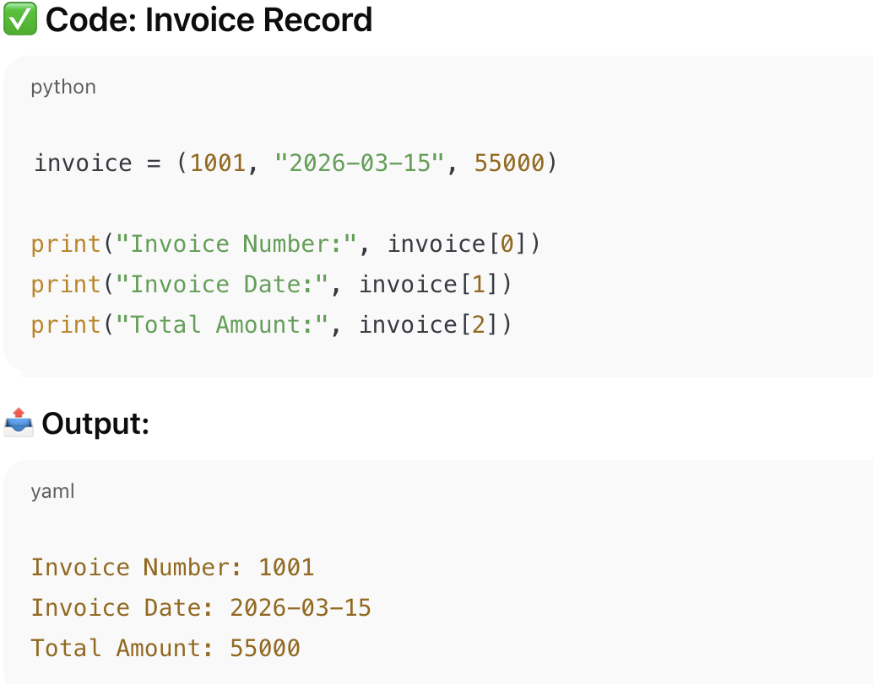
Python Code for using Tuples

Slide 6
Example 2: Bank Transaction Record
Data stored:
Transaction ID
Transaction Date
Amount Transferred
Why Tuple?
Bank records must remain unchanged
Editing transactions breaks trust and compliance

Slide 7
Example 1: Daily Sales of a Store
Scenario: A shop records sales every day.
Data stored:
Sales of Day 1
Sales of Day 2
Sales of Day 3
Why List?
New values are added daily
Old values may be corrected
Data is dynamic
Explanation:
“Sales keep changing, so we need a structure that allows adding and updating values. That’s why we use a list.”

Slide 8
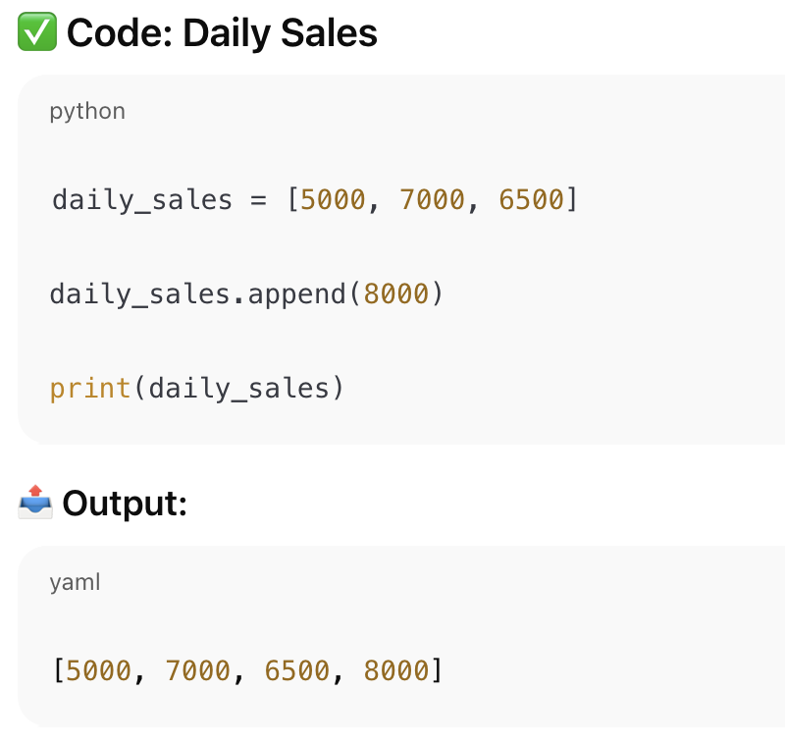
Python code for using Lists

Slide 9
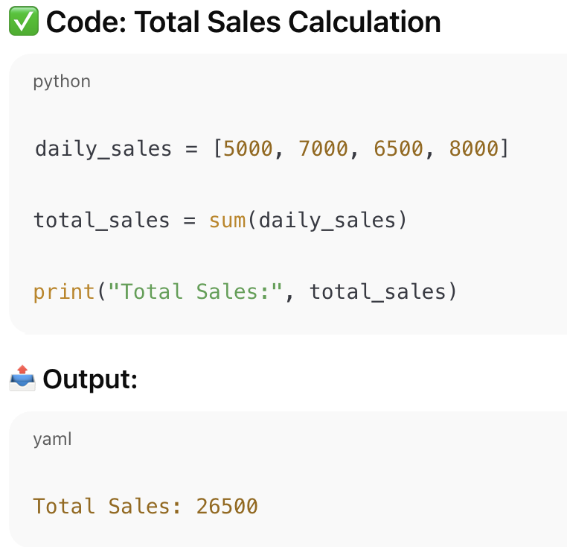
Python code for using Lists

Slide 10
Example 2: Monthly Expenses
Data stored:
Rent
Electricity bill
Internet bill
Miscellaneous expenses
Why List?
Expenses can be updated
New expense categories can be added

Slide 11
Example 1: Unique Customers Visiting a Store
Scenario: A company wants to know how many different customers visited today.
Data situation:
Same customer may visit multiple times
Why Set?
Set automatically removes duplicates
Each customer counted only once
Explanation:
“We want unique customers, not number of visits. A set gives us uniqueness.”

Slide 12
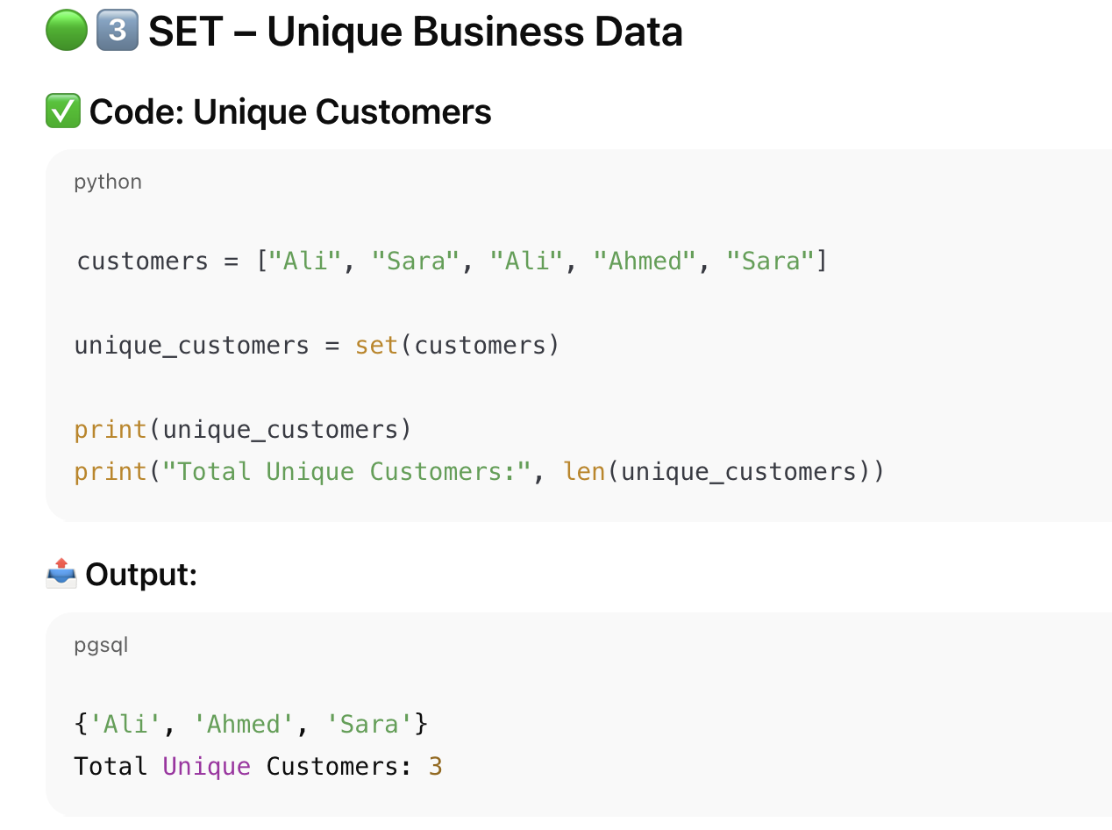

Slide 13
Example 2: Registered Email Addresses
Why Set?
Email addresses must be unique
Duplicate emails cause login and marketing issues
Why not List ?
Problem with List:
Allows duplicate entries
Same customer counted multiple times
Leads to wrong marketing decisions

Slide 14
Example 1: Employee Salary System
Scenario: Human Resources needs to store employee salaries.
Data stored:
Employee ID → Salary
Why Dictionary?
Employee ID is unique (key)
Salary is linked to that ID (value)
Fast and clear lookup
Explanation:
“If I know the employee ID, I should immediately get the salary. That’s exactly what a dictionary does.”

Slide 15
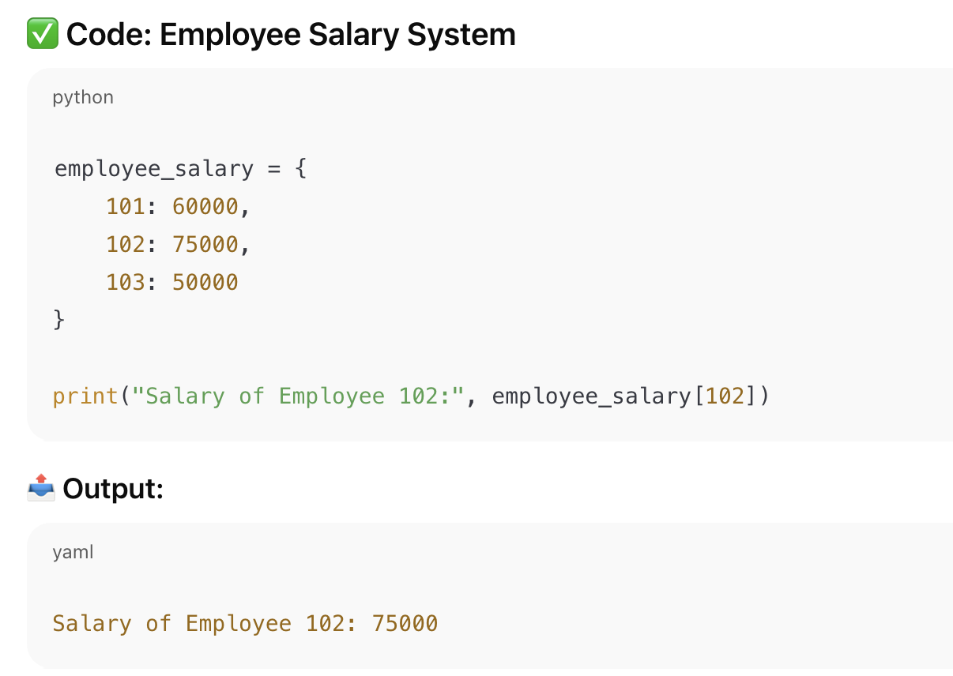

Slide 16
Example 2: Product Code → Price
Scenario: Retail system stores product prices.
Why Dictionary?
Product code identifies price
Easy price update without confusion
❌ Why List and Set FAIL Here
List: No label, just values → confusing
Set: Cannot store salary against ID

Slide 17
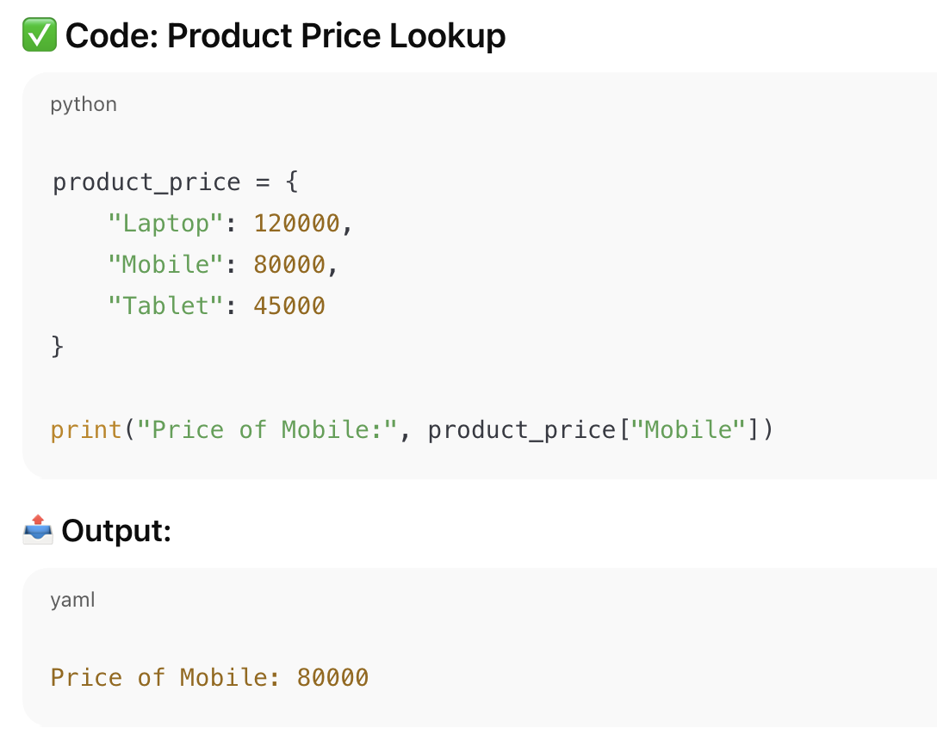

Slide 18
High-Level Comparison
List:
Multiple values
Can change
Tuple:
Multiple values
Cannot change
Set:
Unique values only
Dictionary:
Key → Value mapping

Slide 19
Decision Making in Programs
Decision structures allow programs to behave differently based on conditions.

Slide 20
Company Use Case: Loan Approval
If customer income is sufficient → approve loan
Else → reject loan

Slide 21
if Statement – Explained
An if statement executes logic only when condition is true.

Slide 22
if Example – Business
If purchase amount > 50,000
Apply discount

Slide 23
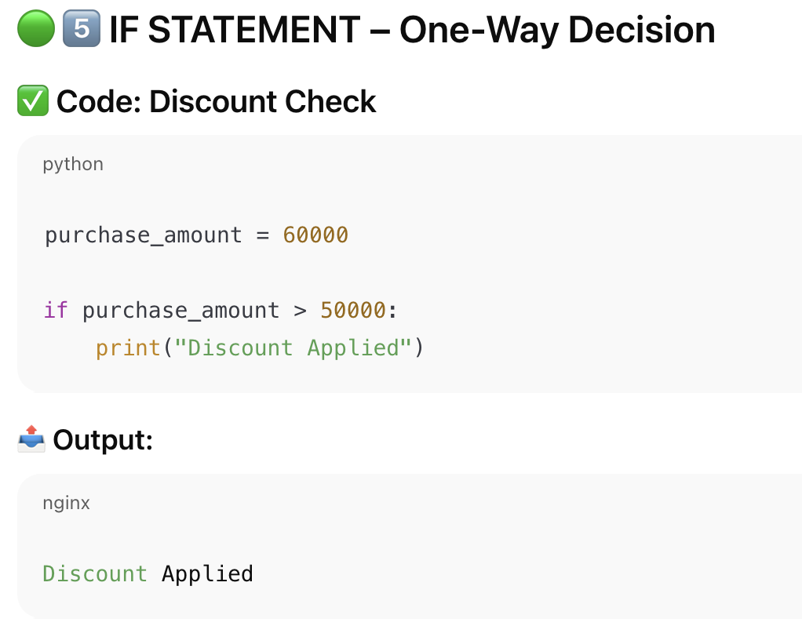

Slide 24
Why if-else Is Needed
Businesses must handle both outcomes.
Missing else creates ambiguity.

Slide 25
if-else – Company Use Case
If target achieved → bonus
Else → no bonus

Slide 26
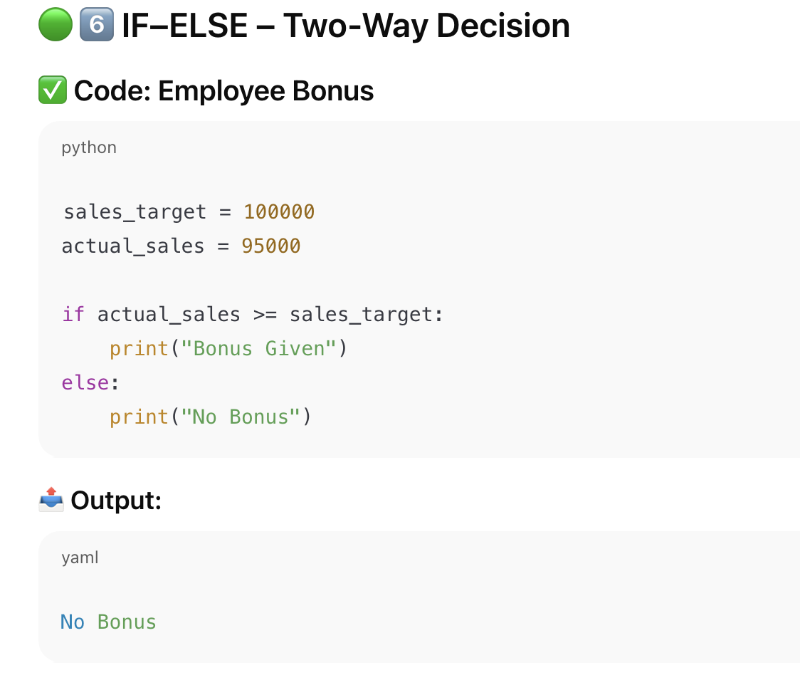

Slide 27
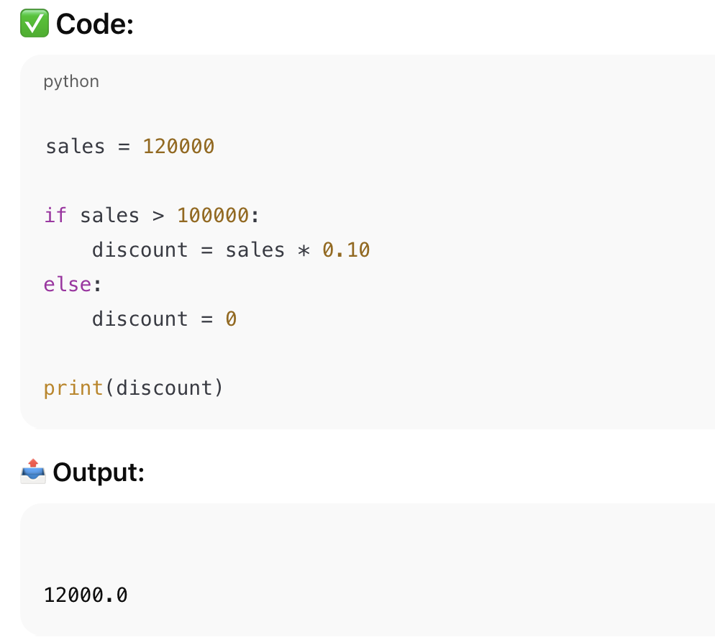
Example for discount applied

Slide 28
Boolean Values
Boolean values represent:
• True
• False

Slide 29
Company Use Case: Payment System
Example 1: Payment Status
Payment successful → True
Payment failed → False
Example 2: User Verification
Verified user → True
Not verified → False

Slide 30
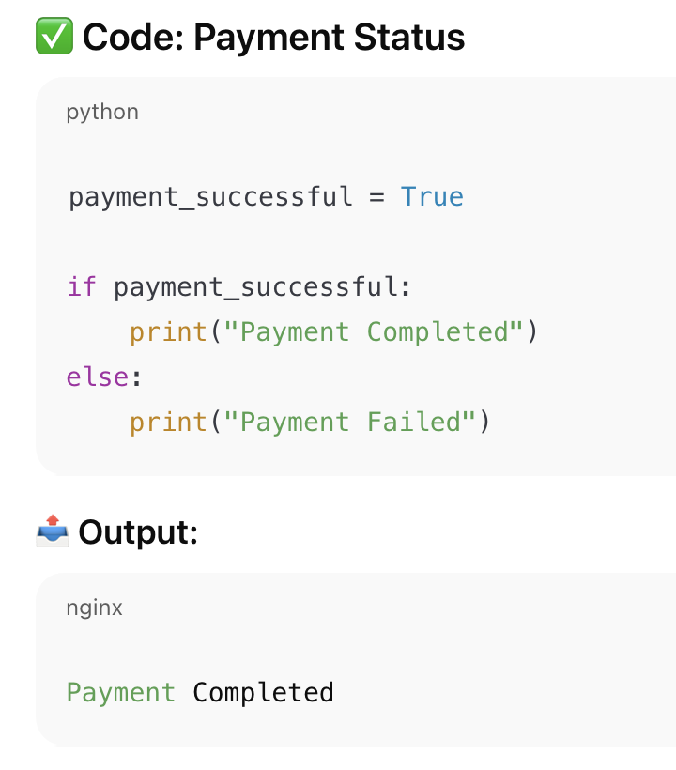

Slide 31
Logical AND – Explained
AND requires all conditions to be true.

Slide 32
AND OPERATOR
Example: If user is verified AND payment is successful → Confirm order

Slide 33
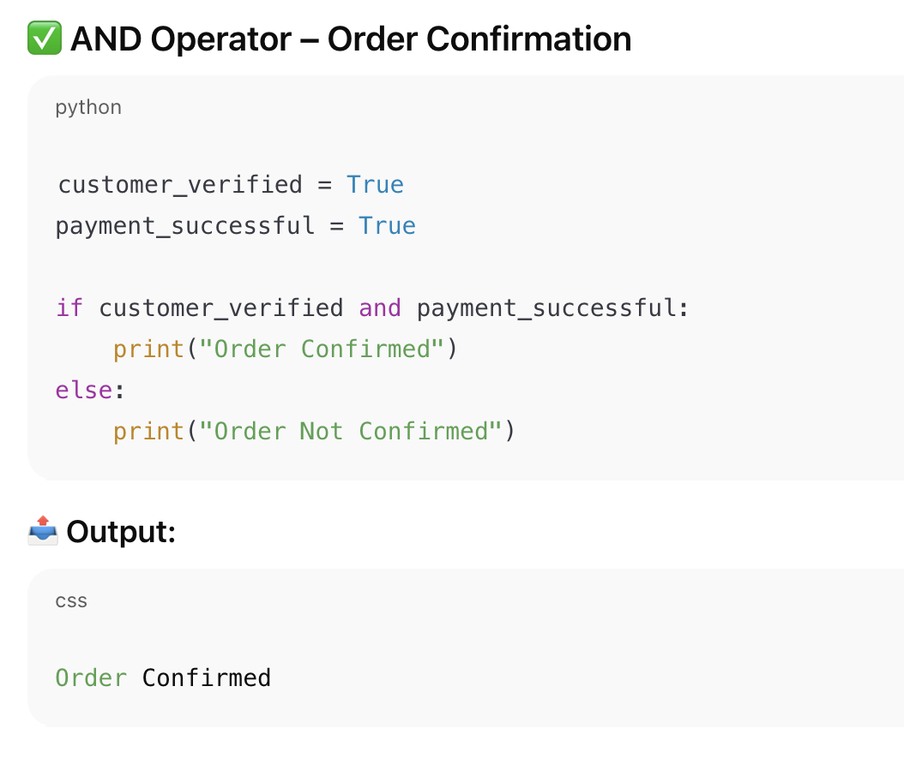

Slide 34
Logical OR – Explained
OR requires at least one condition to be true.
Notes:
Explain flexibility.

Slide 35
OR OPERATOR
Example: If customer is premium OR purchase > 100,000 → Free delivery

Slide 36
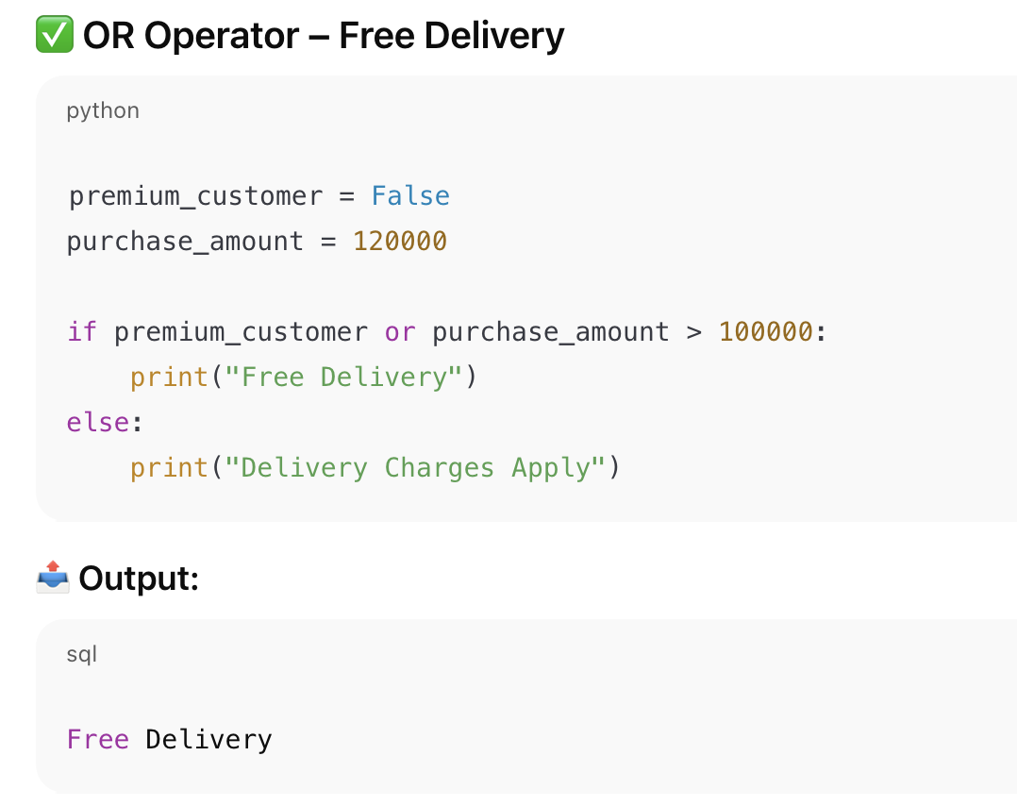

Slide 37
Logical NOT – Explained
NOT reverses a condition.

Slide 38
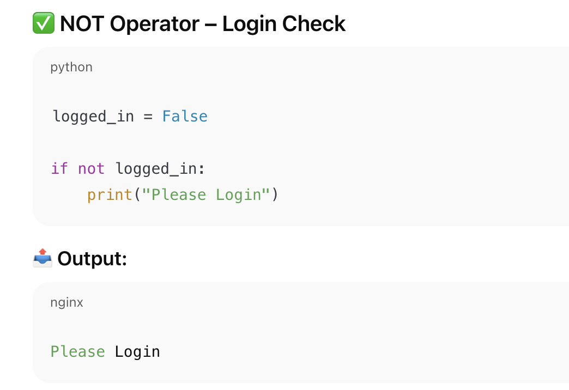
NOT OPERATOR
Example: If user is NOT logged in → Ask to login

Slide 39
Activity 2 – Output Based
sales = 120000
if sales > 100000:
discount = True
else:
discount = False
Output: True
Notes:
Ask students to trace condition.

Slide 40
Assignment
Design a simple system for:
• Discount calculation
• Employee salary lookup
• Unique customer tracking

Slide 41
Assignment – How to Answer
1. Describe data
2. Choose structure
3. Explain decision logic

